Slide 1



MEETING IS
STARTING
SOON
FOLLOW US!
@tidaltamu

Slide 2
t i d a l t a m u
TETHERED INFORMATICS & DATA ANALYTICS LAB
Notes:
Follow us on Twitter and Instagram @tidaltamu
Join our discord and slack, links provided in email

Slide 3
Introduction to Pandas, Matplotlib, Derivative and Gradient, Linear Regression
Ishaan Grewal and Saini Ye

Slide 4

What is Pandas?
Notes:
Python package for data organization, manipulation, and analysis
“Excel for python”
Useful for handling large amounts of data effectively

Slide 5

What is Matplotlib?
Notes:
Python package for creating plots and graphs
Used for data visualization and interpretation

Slide 6
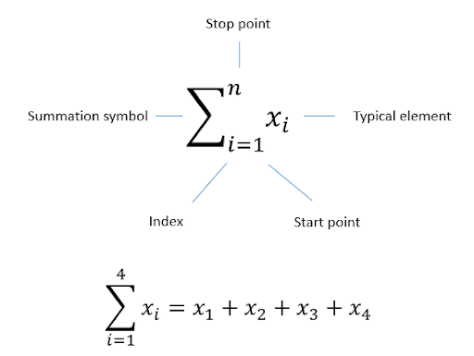
Capital Sigma Notation → Summation
Notes:
Represent a series in a compact form
The greek capital letter sigma

Slide 7
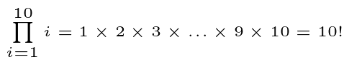
Capital Pi Notation → Product
Notes:
Also called the product notation
It is used in mathematics to represent the product of a bunch of factors or we could say the symbol is used to indicate repeated multiplication.
It gives a ‘closed form’ expression provides a compact way to represent many product
Closed form: one that allows you to describe each factor’s value using its factor number

Slide 8
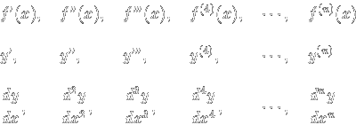
Derivative and Gradient
Derivative:
The derivative of a function represents an infinitesimal change in the function with respect to one of its variables
The slope in an arbitrary specified direction
Gradient
The same as the term slope, or
An angle/vector which points to the direction of the steepest ascent of a curve
Notes:
Apply different/multiple rules to different functions: product rule, quotient rule, power rule, chain rule, partial derivative
Different notations to represent first derivative, second derivative …
The clear picture of both concepts will be shown later in the code portion with Ishaan. Right now i’ll just go over the conceptual portion
In general, the derivative, or we say the directional derivative is the slope in an arbitrary specified direction. Whereas the gradient is a vector with the slope of the function along with of the coordinate axis.

Slide 9
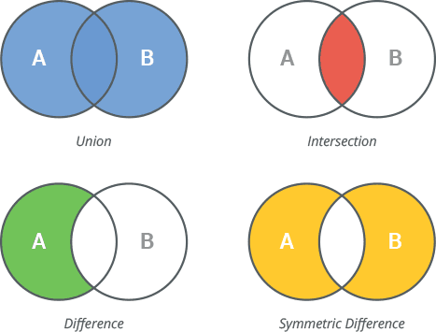
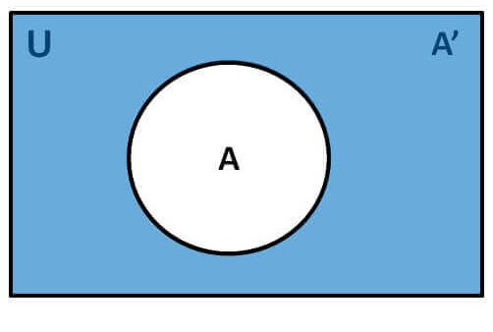
Operation on Sets
Notes:
Move on to statistics
Intersection: all elements which are in both A and B
Union: all elements which are in either A or B (or both)
Difference: all elements are in A but not in B
complement: all elements which are not in A

Slide 10
Random Variable
A real-valued function of the outcome of the experiment
→ discrete and continuous
→ discrete: takes on only a countable number of distinct values
→ continuous: takes an infinite number of possible values
Notes:
A random variable is numerical description of the outcome of a statistical experiment, we also say that it is a real-valued function of the outcome of the experiment. A
typical example will be the number of heads you would observe when flipping a coin by a number of times.
Discrete random variable are usually counts ( ex: number of heads or tails observed when flipping a coin)
Continuous random variable are usually measurement ( your height, weight)

Slide 11
Unbiased Estimators
Estimator → a statistic that estimates some fact about the population
Unbiased estimator:
An accurate statistic that’s used to approximate a population parameter
→ neither an overestimate nor an underestimate
→ estimator (i.e. the sample mean) equals the parameter (i.e. the population mean)
Notes:
You can also think of an estimator as the rule that creates an estimate. For example, the sample mean is an estimator for the population mean.
The quantity that is being estimated (i.e. the one you want to know) is called the estimand. For example, let’s say you wanted to know the average height of children in a certain school with a population of 1000 students. You take a sample of 30 children, measure them and find that the mean height is 56 inches. This is your sample mean, the estimator. You use the sample mean to estimate that the population mean (your estimand) is about 56 inches.
Estimators can be described in several ways: biased, efficient, invariant, sufficient, shrinkage. Today we will give a brief introduction to the unbiased estimator.
An estimator is unbiased if the estimator equals the parameter.
Simple way to say it: an estimator of a given parameter is said to be unbiased if its expected value is equal to the true value of the parameter.
Can be obtained by avoiding bias during sampling and data collection process

Slide 12

Bayes’ Rule
The Bayes’ Rule is very useful when we want to compute the probability of A given B→ Pr(A|B) but computing Pr(B|A) is simpler
In the case when event A happened first, and then event B happens
Notes:
A typical example will be the probability of you bringing umbrella to campus vs the probability of tomorrow to be a raining day.
Example = bring umbrella vs raining day
Most often people bring umbrella when they know ahead that tmrw will be a raining day. And the chances of people to bring umbrella will be larger and it will be easy to compute. But what if I ask you what is the probability of tomorrow to be a raining day given the factt that I’ll bring my umbrella? Would it be difficult to compute the probability of that? Yes.

Slide 13
Max and Argmax
Max → gives the largest possible value of a function f(x) for any x in the domain
Argmax → an operation that finds the argument that gives the maximum value from a target function
Notes:
Mathematical function that you may encounter in applied machine learning
Argmax is most commonly used in machine learning for finding the class with the largest predicted probability

Slide 14
Model Representation
The primary goal of most of the machine learning algorithms is to construct a model.
Notes:
More will be show in the code part

Slide 15
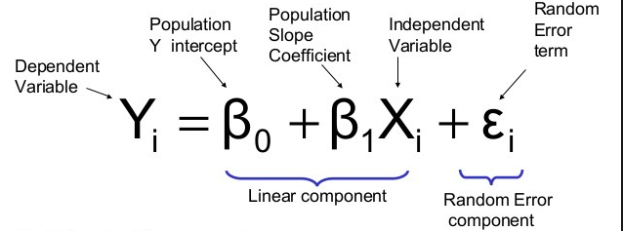
Linear Regression with One Variable
The correlation between the independent variable x and dependent variable y
Minimal error → make prediction more accurate
Notes:
One of the most well understood algorithms in statistics and Machine Learning
Starting one variable is a fundamental step if we want to understand thoroughly how the linear regression works
The goal is to find the fit of the line. The best fit means where the error is minimum. It can make our prediction more accurate.

Slide 16
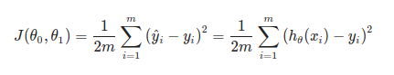
Cost Function
Cost Function helps us to figure out which hypothesis best fits out data → measure the accuracy of the hypothesis
Use equation to determine how wrong the model is in terms of its ability to estimate the relationship between X and Y.
Helps learners to correct/change behavior to minimize mistakes
Notes:
Which basically means how much far away your predicted line is from the actual points that we were already given.
J(theta) is the cost function equation. The h(theta)(xi) is called the hypothesis function which is basically the predicted value, which is the Y.
Theta 0 and theta 1 will be the value from you prediction
The first term 1/2m is a constant term, where m means the number of data points we already have, in our case it’s 3. Then we have a summation sign, this sign means for each changing value in subscript ‘i’ we keep adding the result. The term h(x^i) means the output of our hypothesis for particular value of i, in other words the line you are prediction using equation h(x)=θ0+xθ1 and term y^i means the value of data point we already had. The value ‘i’ means the number of data points we have already calculated the difference of.

Slide 17
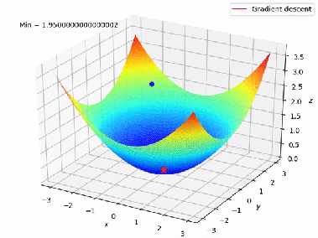
Gradient Descent
An algorithm that attempts to find a local or global minima of a function
Enables model to learn the gradient or direction that the model should take to reduce errors
→ compute the direction of steepest descent and then take a small step downhill and just repeat that over and over again.
Notes:
the algorithm to minimize the function is to compute the direction of steepest descent and then take a small step downhill and just repeat that over and over again until you find the function’s minima.

Slide 18
Gradient Descent for Linear Regression
Recall:
Gradient descent → the process of minimizing a function by following the gradients of the cost function
Linear Regression → a linear system and the coefficients can be calculated analytically using linear algebra

Slide 19
Linear Regression with Multiple Variables
Uses several explanatory variable to predict the outcome of a response variable
→ estimates the relationship between a quantitative dependent variable and two or more independent variables using a straight line
Notes:
Also known simply as multiple regression, is a statistical technique that uses several explanatory variables to predict the outcome of a response variable.

Slide 20
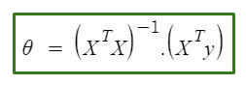
Normal Equation
Technique to compute coefficients for linear regression with multiple variables
→ θ: hypothesis parameters that define it the best
→ X: Input feature value of each instance
→ Y: Output value of each instance
Notes:
The normal equation approach is an effective and a time-saving option when working with a data set with small features.
Q: what are features?

Slide 21
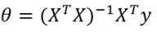
Normal Equation and Non-invertibility
Matrices that do not have an inverse are called singular (non-invertible)
→ Linearly dependent components → can be removed and has no effects
→ Too many features: number of components are greater than the dimension
Notes:
In order to have unique, or a single solution, the X transpose times X must be invertible. When X transpose times X is invertible, the equation implies theta is the unique solution of linear regression. This often happens when we face an overdetermined system → the number of samples is much larger than the number of variables.
When X transpose times X is not invertible, the equation will have infinite number of solutions and so does our linear regression problem.

